Slide 1
Marketing/ Merchandizing and the New Item Process
Chris Burkhardt
Child Nutrition
Lakota Local School District

Slide 2
Discussion Topics- Office Staff
Discuss concept/item 50,000 ft
Discuss target
Discuss competition
  “Borrow” ideas
  “Borrow” marketing
Discuss Challenges
Change to fit HHFKA

Slide 3
Create Buzz (teasers)
Facebook
Twitter
PA Announcements
District newsletter-Fridays
Email select staff
Posters (in house or Liberty printing)
Letter Home
All Call

Slide 4
Media- External
Radio/ TV/ Newspaper
WMKZ Public Radio
WLWT(NBC) Karen Johnson
Pulse Journal-Eric S or Hannah P

Slide 5
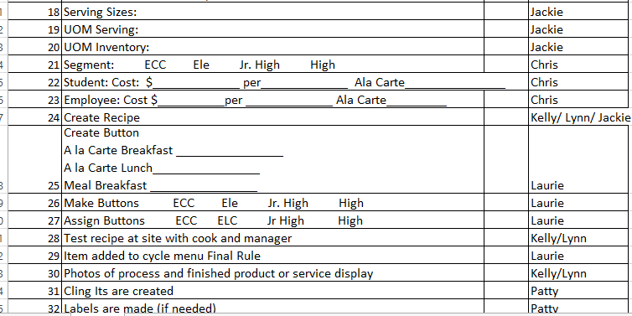
New Item Checklist

Slide 6
Item Process
Discuss at manager meeting
Find ingredients-Brand name?
Test ingredients
Write recipe
Sample recipe
Take photos
On site test

Slide 7
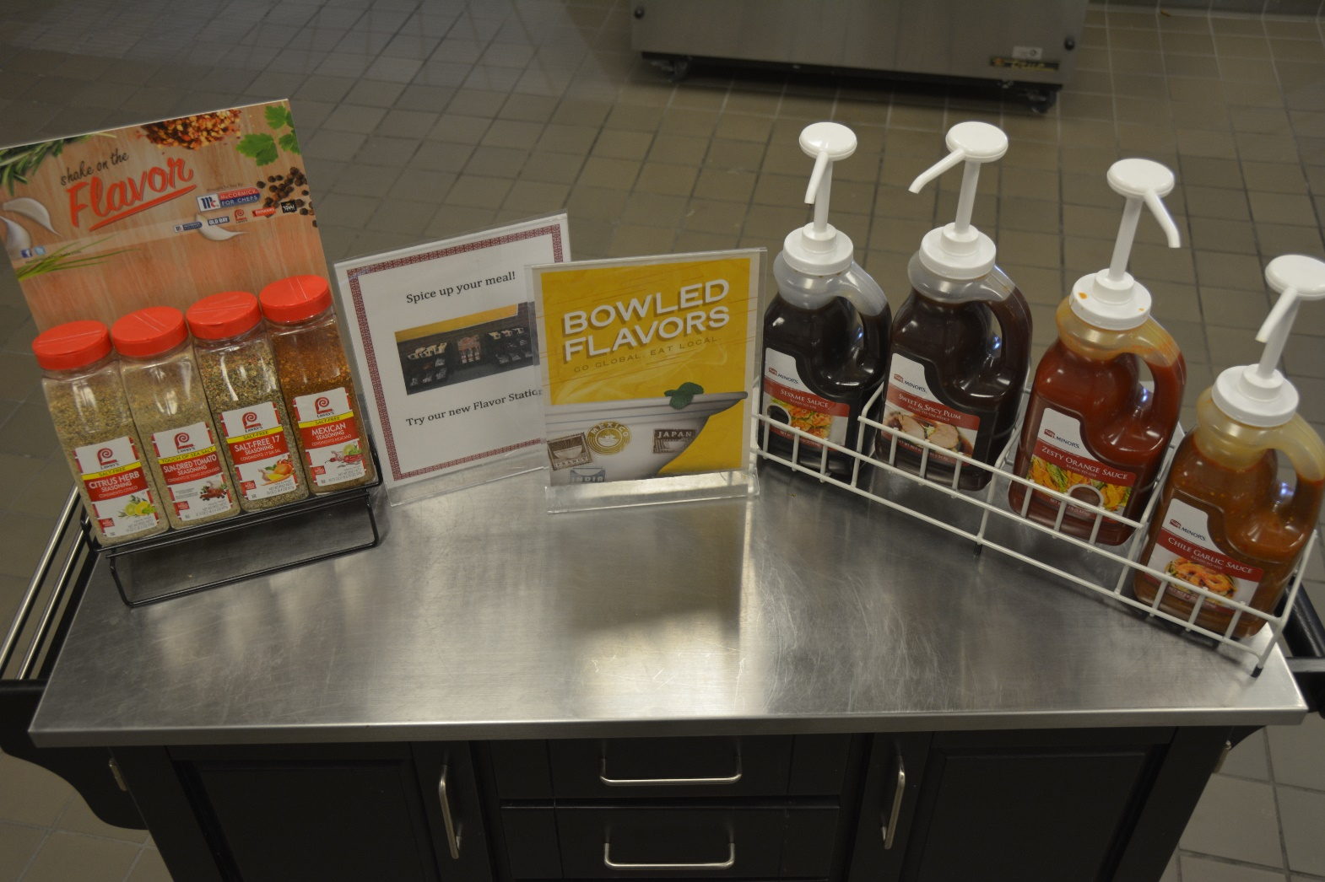
Spice Station

Slide 8
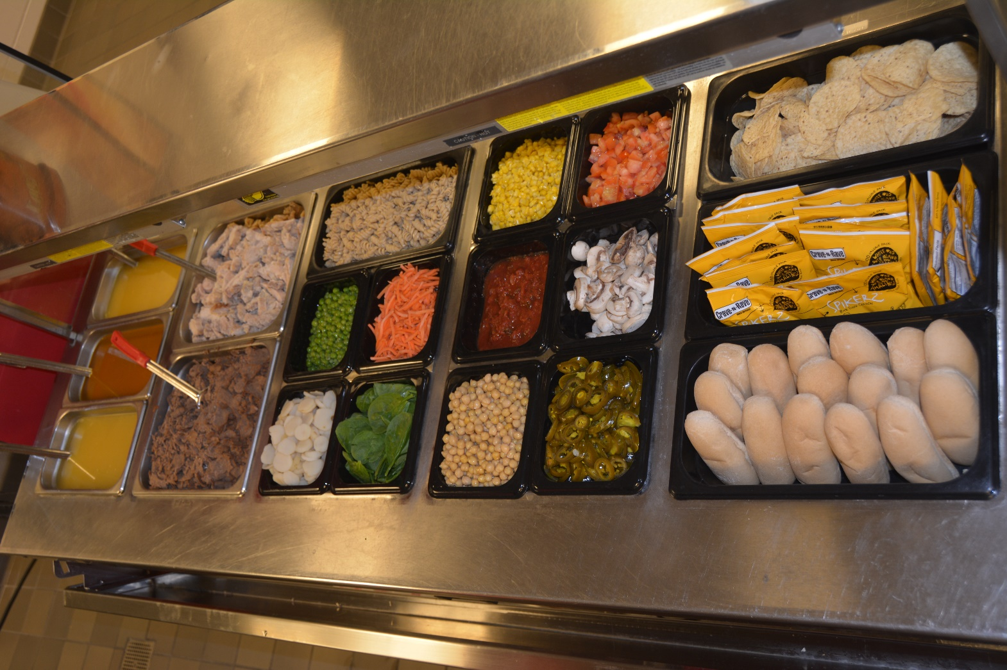
SLURP!

Slide 9
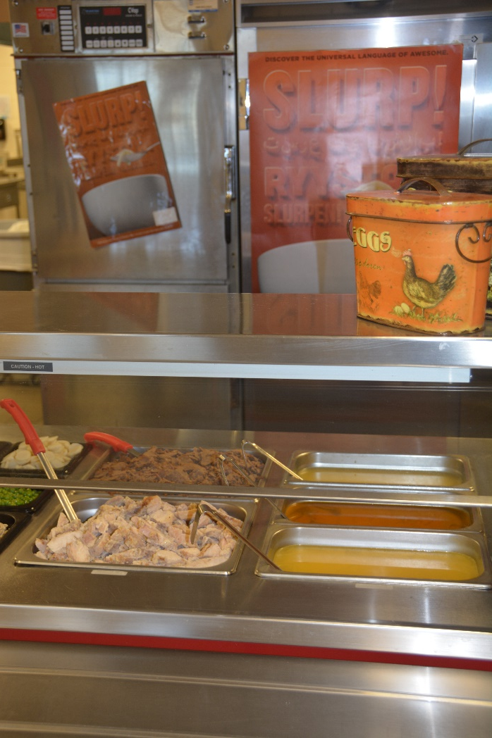
Slurp 2

Slide 10
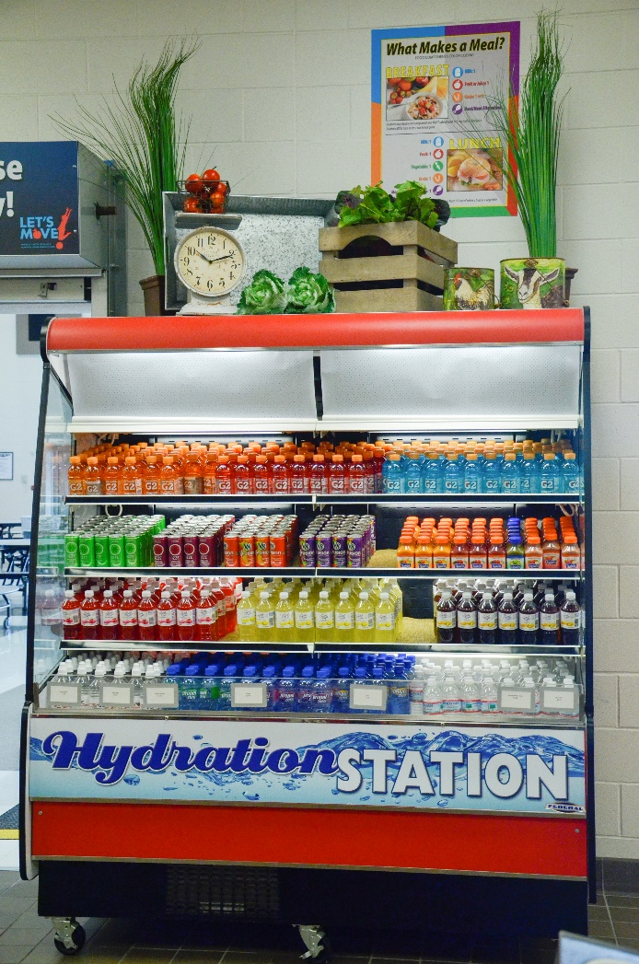
Beverage Options

Slide 11
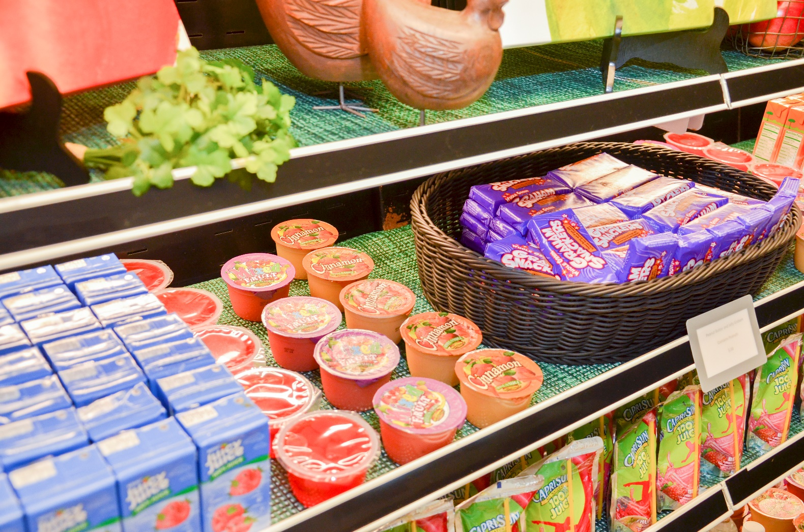
Merchandizing

Slide 12
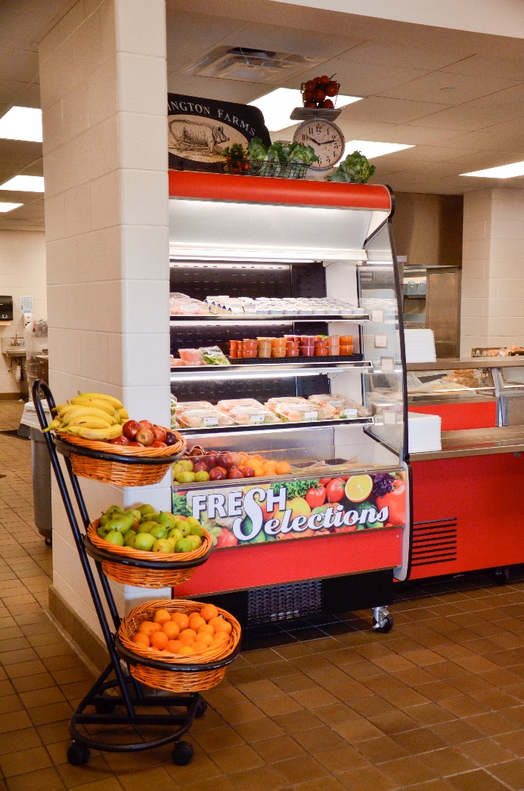
Fresh Selections

Slide 13
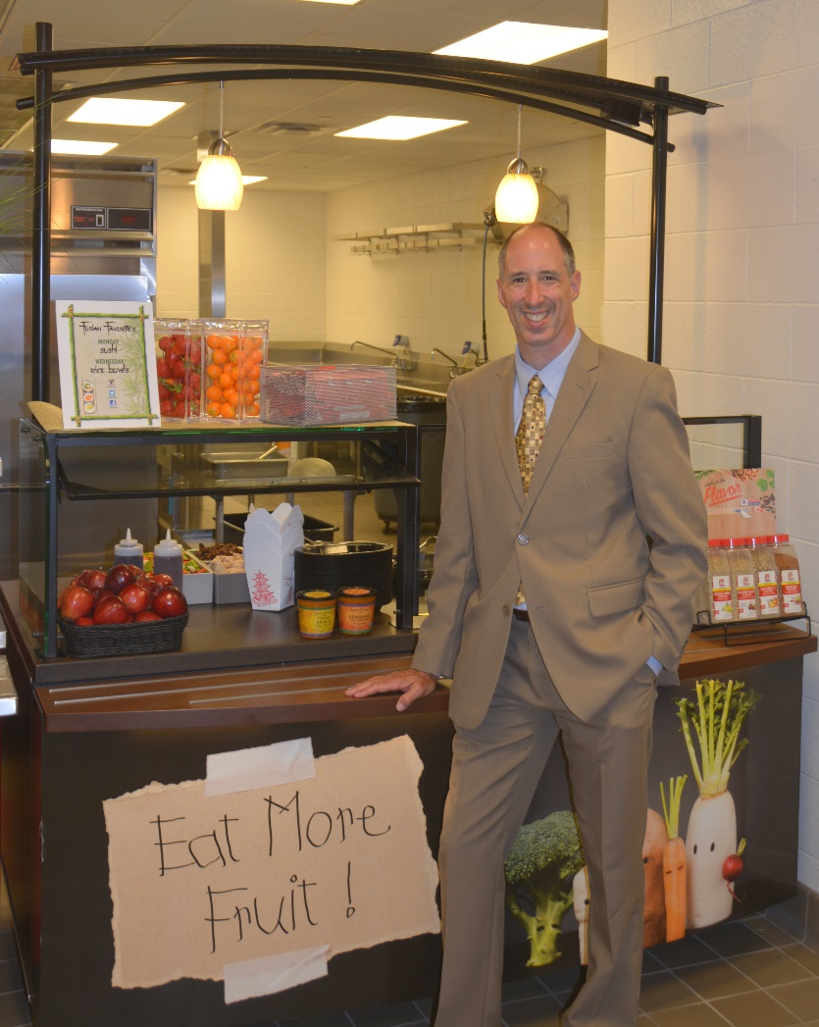
Induction Cooking

